Slide 1
Previous & LSM-trie
Clarifications on last slides & Intro to LSM-trie

Slide 2
Max space limited to be 10^n MB at level n!

Slide 3
Why and When to Compact?
Major Compaction
Limited Size on each level
Some SSTs are frequented with meaningless return value
Minor Compaction
Memory Table is full

Slide 4
Limitations on Log Structured Indexes
Trade-off between “write” & “read” performances
-> Excessive read amplification
-> Exhaustive Lookups & Seeks during Inserts
-> Write Pauses
So bLSM Tree it is !

Slide 5
How is bLSM Tree?
N means the level of LSM tree and n means the size of each SST!

Slide 6
Key-Value Store
Small KV items -> Widespread
Capacity on single KV server -> Increasing
Performance on write and read -> High

Slide 7
Why LSM trie
Large Write Amplification Ratio
Worst case: 10 SSTs needed to be merged for one higher level SST
Hence there are totally 11 SSTs involved
Write Amplification Ratio -> 11!
11 = 1 + 10 in which 10 is the default amplification factor(AF)
For one simple KV to reach the level n
The ratio could reach to (1 + AF) * n

Slide 8
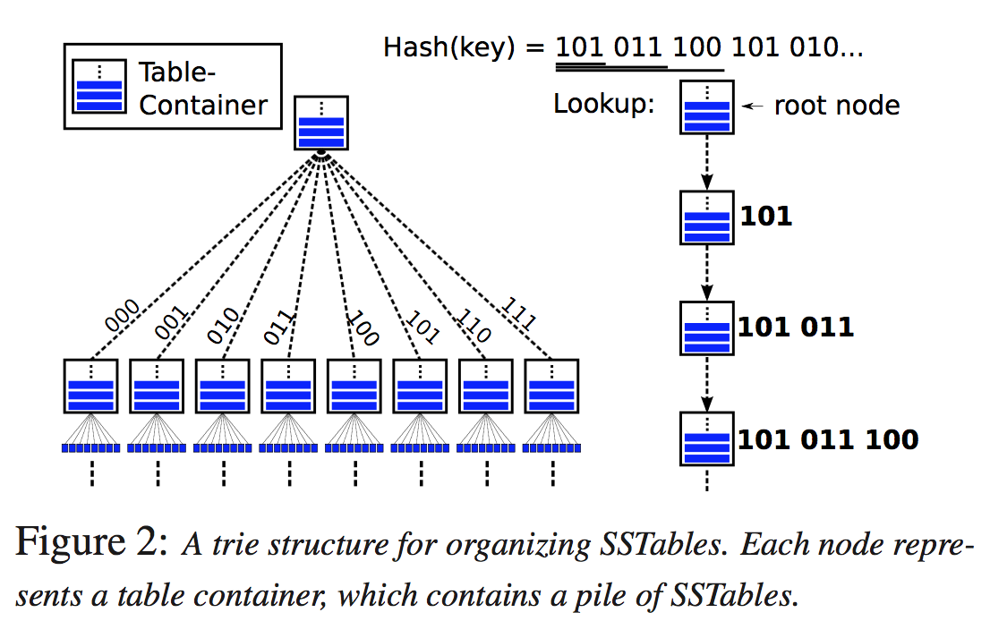
What is LSM-trie?

Slide 9
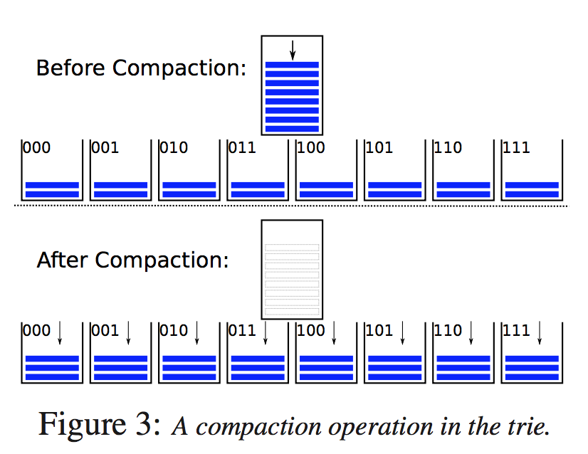
How LSM-trie compacts?

Slide 10
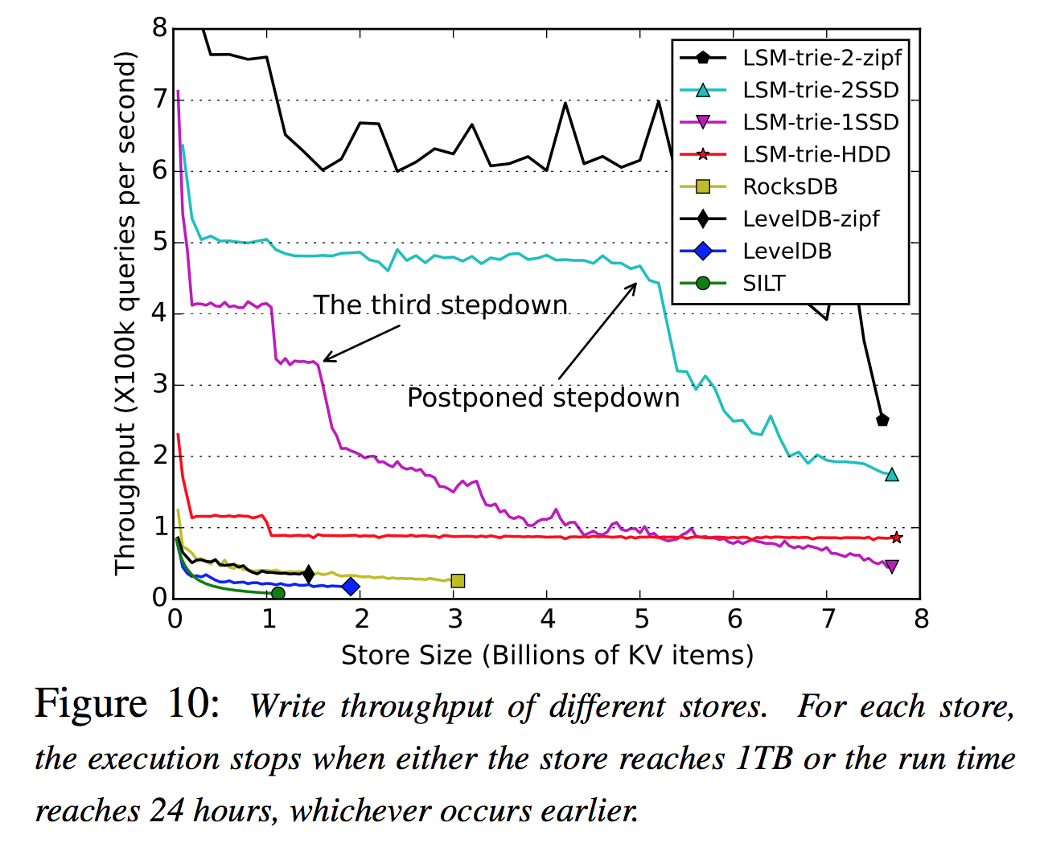
How is LSM-trie?

